Slide 1


EVA²: Exploiting Temporal Redundancy In Live Computer Vision
Mark Buckler, Philip Bedoukian, Suren Jayasuriya, Adrian Sampson
International Symposium on Computer Architecture (ISCA)
Tuesday June 5, 2018

Slide 2
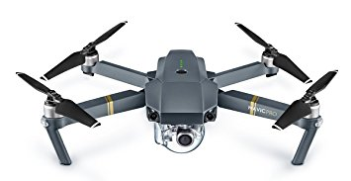
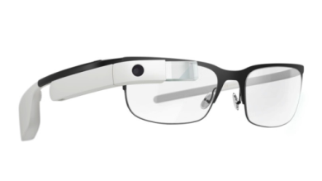
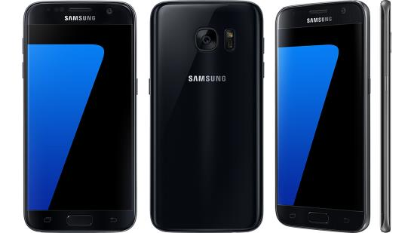
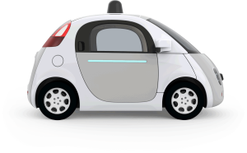
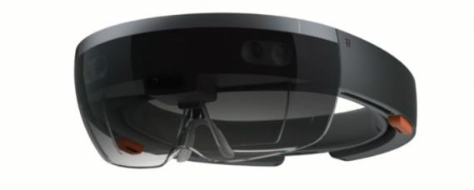
Convolutional Neural
Networks (CNNs)

Slide 3

Convolutional Neural
Networks (CNNs)

Slide 4
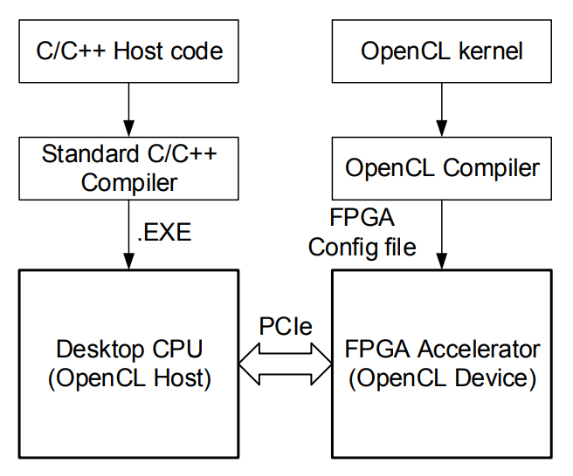
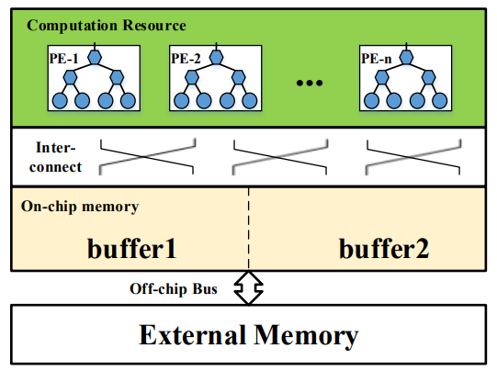
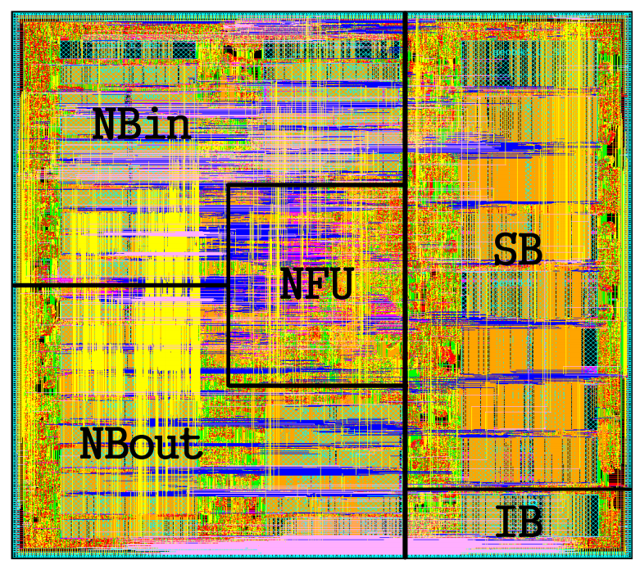
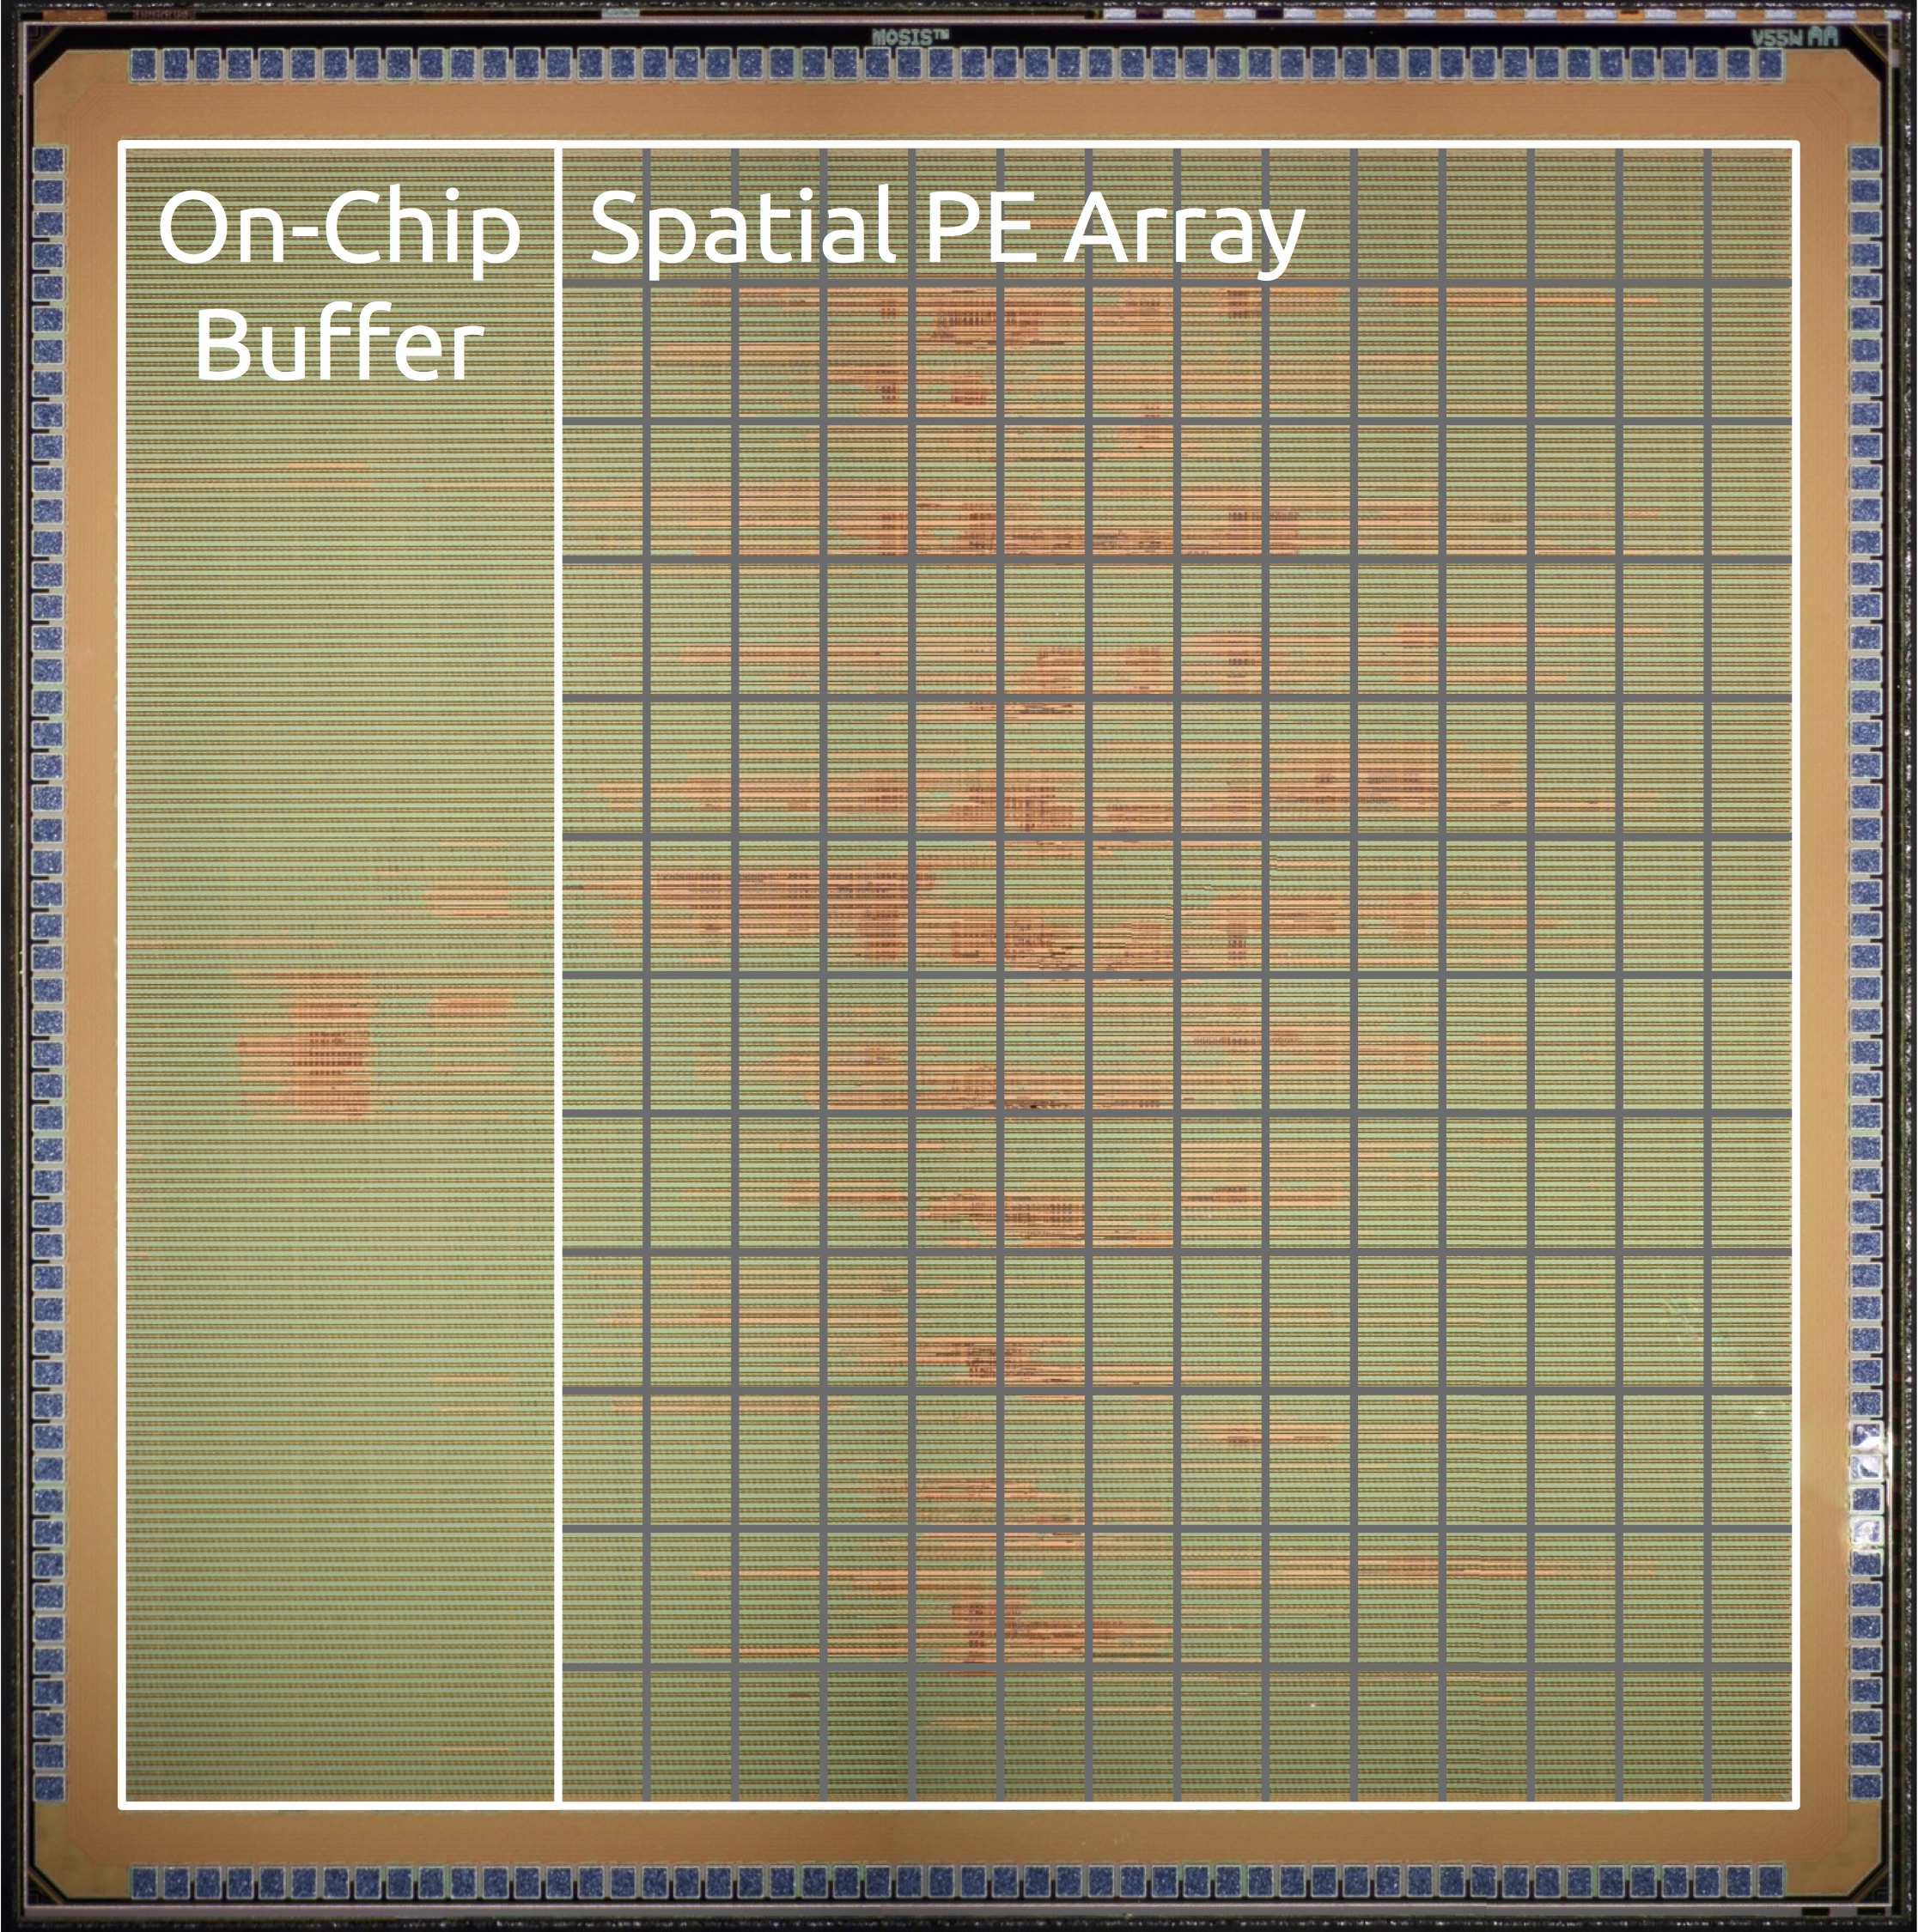

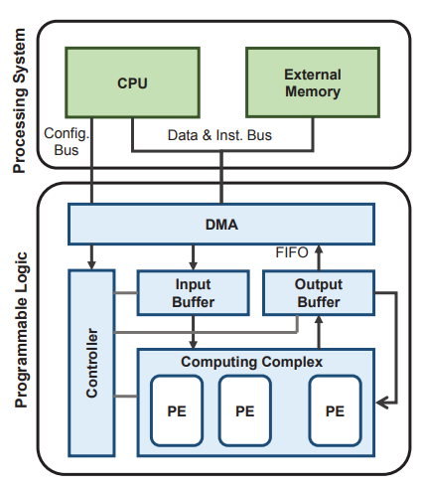
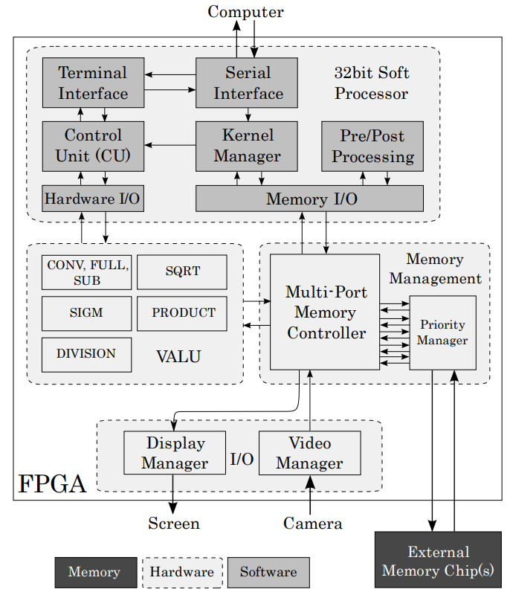
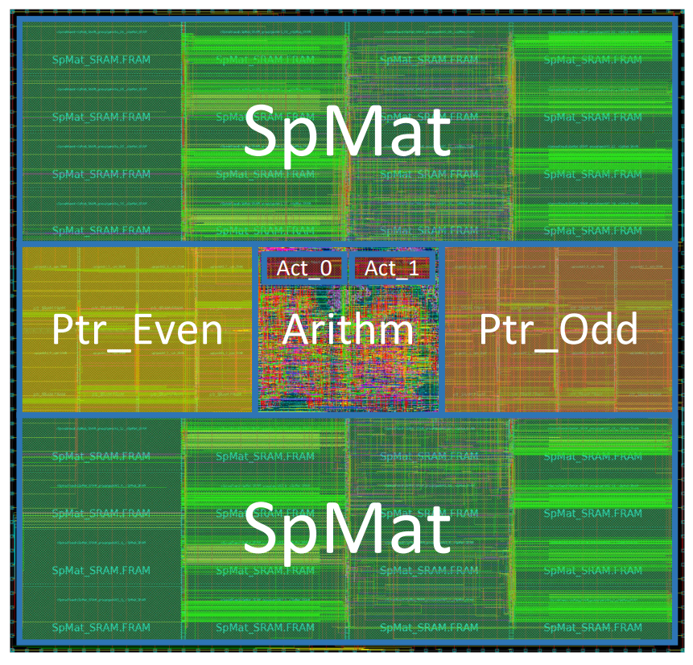
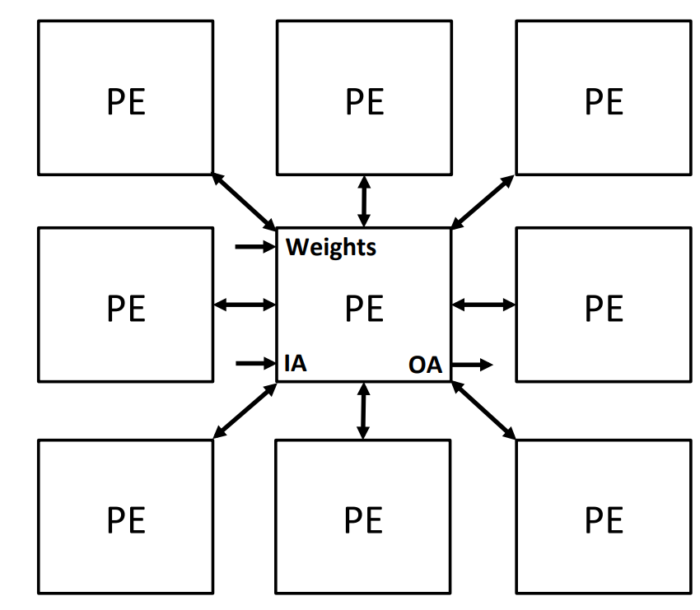






FPGA Research
ASIC Research
Embedded Vision
Accelerators
Suda et al.
Zhang et al.
ShiDianNao
Eyeriss
Qiu et al.
Farabet et al.
EIE
SCNN
Many more…
Many more…
Industry Adoption

Slide 5




Temporal Redundancy
Frame 0
Frame 1
Frame 2
Frame 3
Input Change
High
Low
Low
Low

Slide 6
Temporal Redundancy
Frame 0
Frame 1
Frame 2
Frame 3
Input Change
High
Low
Low
Low
Cost to
Process
High
High
High
High

Slide 7
Temporal Redundancy
Frame 0
Frame 1
Frame 2
Frame 3
Input Change
High
Low
Low
Low
Cost to
Process
High
Low
High
Low
High
High
Low

Slide 8

Talk Overview
Background
Algorithm
Hardware
Evaluation
Conclusion
Notes:
Hardware software codesign in the spirit of what Patterson and Hennesy suggested yesterday

Slide 9
Talk Overview
Background
Algorithm
Hardware
Evaluation
Conclusion

Slide 10
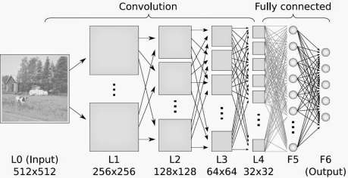
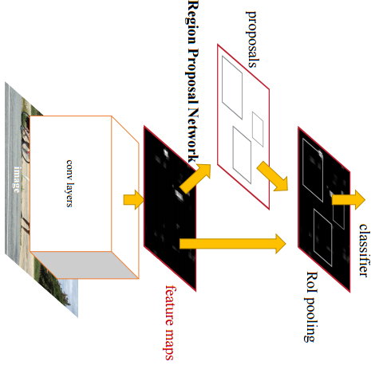
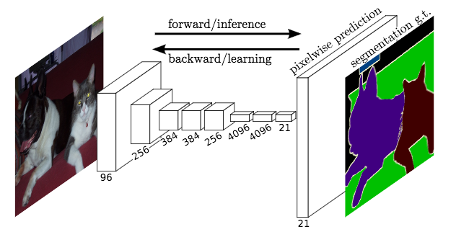
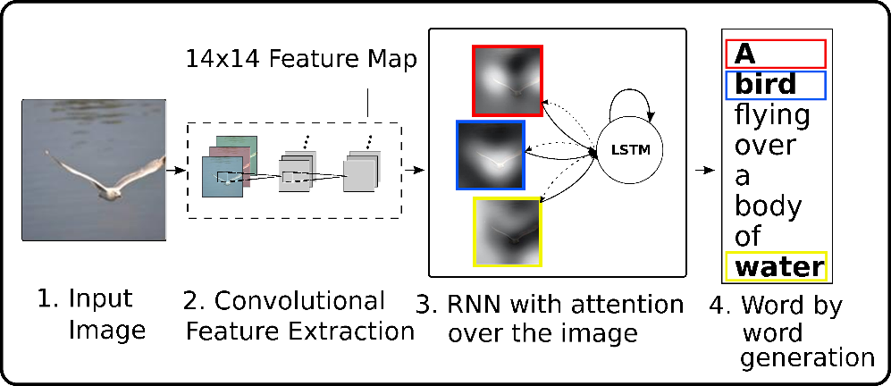
Common Structure in CNNs
Image Classification
Object Detection
Semantic Segmentation
Image Captioning

Slide 11

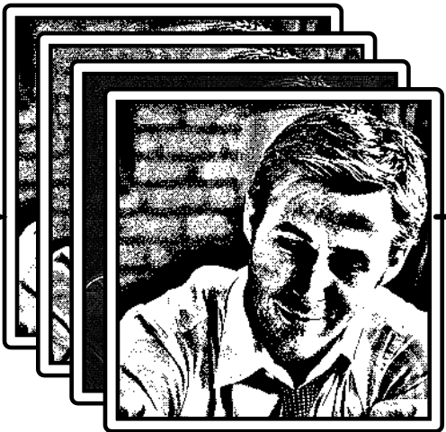
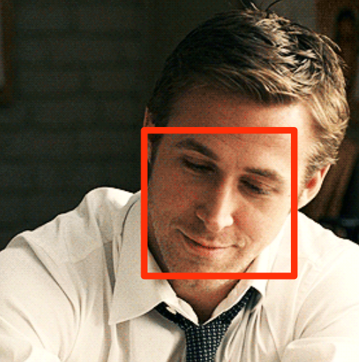

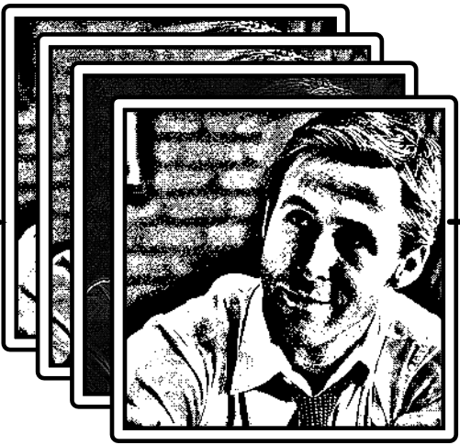
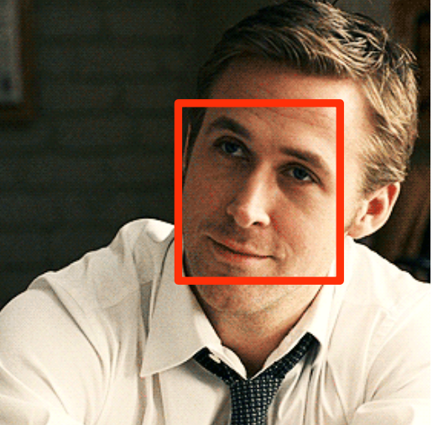
Common Structure in CNNs
Intermediate Activations
CNN
Prefix
CNN
Suffix
Frame 0
High energy
Low energy
CNN
Prefix
CNN
Suffix
Frame 1
High energy
Low energy
#MakeRyanGoslingTheNewLenna

Slide 12

Common Structure in CNNs
Intermediate Activations
CNN
Prefix
CNN
Suffix
“Key Frame”
High energy
Low energy
Motion
$$≈$$
Motion
CNN
Prefix
CNN
Suffix
“Predicted Frame”
High energy
Low energy
#MakeRyanGoslingTheNewLenna
Notes:
Very similar, and what change that does exist is motion

Slide 13
Common Structure in CNNs
Intermediate Activations
CNN
Prefix
CNN
Suffix
“Key Frame”
High energy
Low energy
Motion
$$≈$$
Motion
CNN
Prefix
CNN
Suffix
“Predicted Frame”
Low energy
#MakeRyanGoslingTheNewLenna

Slide 14
Talk Overview
Background
Algorithm
Hardware
Evaluation
Conclusion

Slide 15

Activation Motion Compensation (AMC)
Time
Input Frame
Vision Computation
Vision Result
Stored Activations
CNN
Prefix
CNN
Suffix
Key
Frame
t
Motion Estimation
Motion Compensation
CNN
Suffix
Predicted
Frame
t+k
Motion
Vector Field
Predicted
Activations

Slide 16
Activation Motion Compensation (AMC)
Time
Input Frame
Vision Computation
Vision Result
Stored Activations
CNN
Prefix
CNN
Suffix
Key
Frame
t
~10¹¹ MACs
Motion Estimation
Motion Compensation
CNN
Suffix
Predicted
Frame
t+k
~10⁷ Adds
Motion
Vector Field
Predicted
Activations

Slide 17
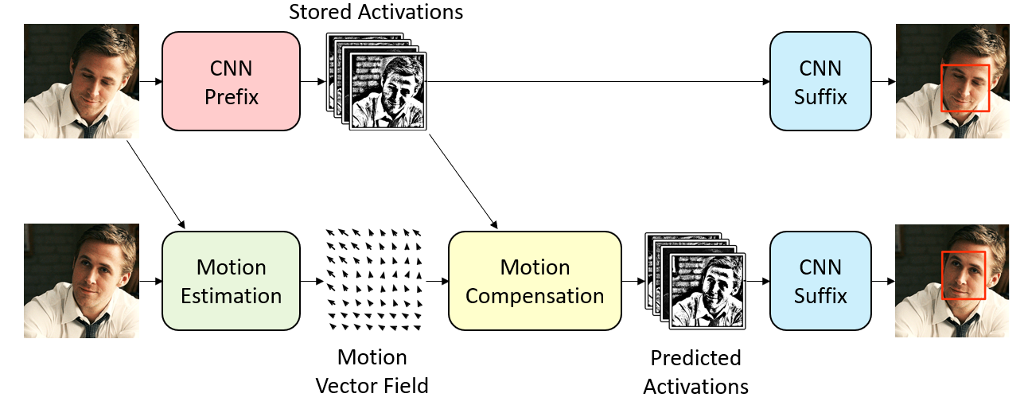
AMC Design Decisions
How to perform motion estimation?
How to perform motion compensation?
Which frames are key frames?

Slide 18
AMC Design Decisions
How to perform motion estimation?
How to perform motion compensation?
Which frames are key frames?

Slide 19
AMC Design Decisions
How to perform motion estimation?
How to perform motion compensation?
Which frames are key frames?

Slide 20
AMC Design Decisions
How to perform motion estimation?
How to perform motion compensation?
Which frames are key frames?
?

Slide 21
AMC Design Decisions
How to perform motion estimation?
How to perform motion compensation?
Which frames are key frames?

Slide 22
Motion Estimation
We need to estimate the motion of activations by using pixels…
CNN
Prefix
CNN
Suffix
Motion Estimation
Motion Compensation
CNN
Suffix
Performed on
Pixels
Performed on
Activations
Notes:
Motion estimation needs to be cheap

Slide 23
Pixels to Activations
3x3 Conv
64
3x3 Conv
64
Input Image
Intermediate
Activations
Intermediate
Activations

Slide 24
Pixels to Activations: Receptive Fields
C=64
C=64
C=3
w=h=8
3x3 Conv
64
3x3 Conv
64
Input Image
Intermediate
Activations
Intermediate
Activations

Slide 25
Pixels to Activations: Receptive Fields
C=64
C=64
C=3
w=h=8
5x5 “Receptive Field”
3x3 Conv
64
3x3 Conv
64
Input Image
Intermediate
Activations
Intermediate
Activations
Estimate motion of activations by estimating motion of receptive fields
Notes:
If the pixels within that receptive field move, then the activation will move accordingly

Slide 26
Receptive Field Block Motion Estimation (RFBME)
…
…
Key Frame
Predicted Frame

Slide 27
Receptive Field Block Motion Estimation (RFBME)
0
1
2
3
0
1
2
3
Key Frame
Predicted Frame

Slide 28
Receptive Field Block Motion Estimation (RFBME)
0
1
2
3
0
1
2
3
Key Frame
Predicted Frame

Slide 29
AMC Design Decisions
How to perform motion estimation?
How to perform motion compensation?
Which frames are key frames?

Slide 30
Motion Compensation
C=64
C=64
Vector:
X = 2.5
Y = 2.5
Stored Activations
Predicted Activations
Subtract the vector to index into the stored activations
Interpolate when necessary

Slide 31
AMC Design Decisions
How to perform motion estimation?
How to perform motion compensation?
Which frames are key frames?
?

Slide 32
When to Compute Key Frame?
System needs a new key frame when motion estimation fails:
De-occlusion
New objects
Rotation/scaling
Lighting changes

Slide 33
When to Compute Key Frame?
Input Frame
Key Frame
System needs a new key frame when motion estimation fails:
De-occlusion
New objects
Rotation/scaling
Lighting changes
So, compute key frame when RFBME error exceeds set threshold
Motion Estimation
Yes
Error > Thresh?
No
CNN
Prefix
Motion Compensation
CNN
Suffix
Vision Result

Slide 34
Talk Overview
Background
Algorithm
Hardware
Evaluation
Conclusion

Slide 35
Embedded Vision Accelerator
Global Buffer
Eyeriss
(Conv)
EIE
(Full Connect)
CNN
Prefix
CNN
Suffix
Y.-H. Chen, T. Krishna, J. S. Emer, and V. Sze,
“Eyeriss: An energy-efficient reconfigurable accelerator for deep convolutional neural networks,”
S. Han, X. Liu, H. Mao, J. Pu, A. Pedram, M. A. Horowitz, and W. J. Dally,
“EIE: Efficient inference engine on compressed deep neural network,”
Notes:
Eyeriss: systolic array based, for convs
EIE: sparsity based, for fully connected

Slide 36
Embedded Vision Accelerator Accelerator (EVA²)
Global Buffer
EVA²
Eyeriss
(Conv)
EIE
(Full Connect)
Motion Estimation
Motion Compensation
CNN
Prefix
CNN
Suffix
Y.-H. Chen, T. Krishna, J. S. Emer, and V. Sze,
“Eyeriss: An energy-efficient reconfigurable accelerator for deep convolutional neural networks,”
S. Han, X. Liu, H. Mao, J. Pu, A. Pedram, M. A. Horowitz, and W. J. Dally,
“EIE: Efficient inference engine on compressed deep neural network,”

Slide 37
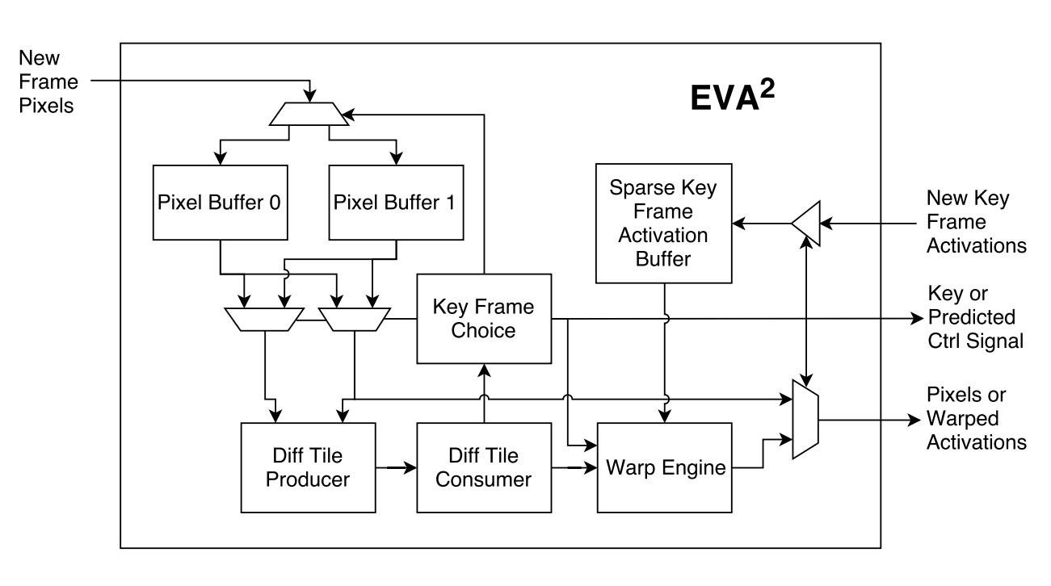
Embedded Vision Accelerator Accelerator (EVA²)
Frame 0

Slide 38
Embedded Vision Accelerator Accelerator (EVA²)
Frame 0: Key frame

Slide 39
Embedded Vision Accelerator Accelerator (EVA²)
Frame 1
Motion Estimation

Slide 40
Embedded Vision Accelerator Accelerator (EVA²)
Frame 1: Predicted frame
Motion Estimation
Motion Compensation
EVA² leverages sparse techniques to save 80-87% storage and computation

Slide 41
Talk Overview
Background
Algorithm
Hardware
Evaluation
Conclusion

Slide 42
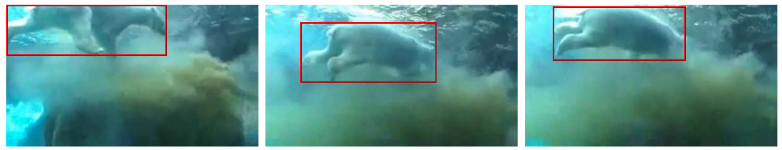
Evaluation Details
Train/Validation Datasets | YouTube Bounding Box: Object Detection & Classification
Evaluated Networks | AlexNet, Faster R-CNN with VGGM and VGG16
Hardware Baseline | Eyeriss & EIE performance scaled from papers
EVA² Implementation | Written in RTL, synthesized with 65nm TSMC

Slide 43
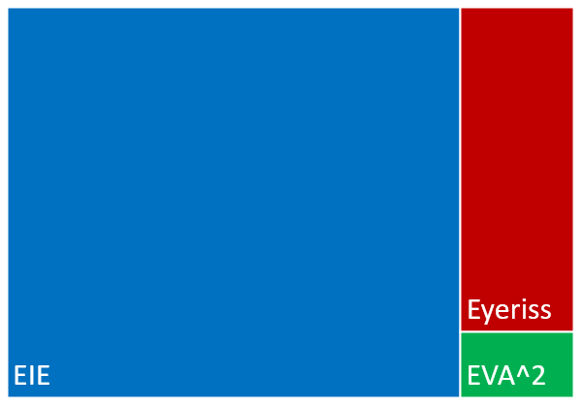
EVA² Area Overhead
Total 65nm area: 74mm²
EVA² takes up only 3.3%

Slide 44
EVA² Energy Savings
Input Frame
CNN
Prefix
CNN
Suffix
Vision Result
Notes:
Address that convolutional layers dominate the costs

Slide 45
EVA² Energy Savings
Input Frame
Key Frame
Motion Estimation
Motion Compensation
CNN
Suffix
Vision Result

Slide 46
EVA² Energy Savings
Input Frame
Key Frame
Motion Estimation
Yes
Error > Thresh?
No
CNN
Prefix
Motion Compensation
CNN
Suffix
Vision Result

Slide 47
High Level EVA² Results
EVA² enables 54-87% savings while incurring <1% accuracy degradation
Adaptive key frame choice metric can be adjusted
Network | Vision Task | Keyframe % | Accuracy Degredation | Average Latency Savings | Average Energy Savings
AlexNet | Classification | 11% | 0.8% top-1 | 86.9% | 87.5%
Faster R-CNN VGG16 | Detection | 36% | 0.7% mAP | 61.7% | 61.9%
Faster R-CNN VGGM | Detection | 37% | 0.6% mAP | 54.1% | 54.7%

Slide 48
Talk Overview
Background
Algorithm
Hardware
Evaluation
Conclusion

Slide 49
Conclusion
Temporal redundancy is an entirely new dimension for optimization
AMC & EVA² improve efficiency and are highly general
Applicable to many different…
CNN applications (classification, detection, segmentation, etc)
Hardware architectures (CPU, GPU, ASIC, etc)
Motion estimation/compensation algorithms

Slide 50
EVA²: Exploiting Temporal Redundancy In Live Computer Vision
Mark Buckler, Philip Bedoukian, Suren Jayasuriya, Adrian Sampson
International Symposium on Computer Architecture (ISCA)
Tuesday June 5, 2018

Slide 51
Backup Slides

Slide 52
Why not use vectors from video codec/ISP?
We’ve demonstrated that the ISP can be skipped (Bucker et al. 2017)
No need to compress video which is instantly thrown away
Can save energy by power gating the ISP
Opportunity to set own key frame schedule
However, great idea for pre-stored video!

Slide 53
Why Not Simply Subsample?
If lower frame rate needed, simply apply AMC at that frame rate
Warping
Adaptive key frame choice

Slide 54
Different Motion Estimation Methods
Faster16
FasterM

Slide 55
Difference from Deep Feature Flow?
Deep Feature Flow does also exploit temporal redundancy, but…
 | AMC and EVA² | Deep Feature Flow
Adaptive key frame rate? | Yes | No
On chip activation cache? | Yes | No
Learned motion estimation? | No | Yes
Motion estimation granularity | Per receptive field | Per pixel (excess granularity)
Motion compensation | Sparse (four-way zero skip) | Dense
Activation storage | Sparse (run length) | Dense

Slide 56
Difference from Euphrates?
Euphrates has a strong focus on SoC integration
Motion estimation from ISP
May want to skip the ISP to save energy & create more optimal key schedule
Motion compensation on bounding boxes
Skips entire network, but is only applicable to object detection

Slide 57
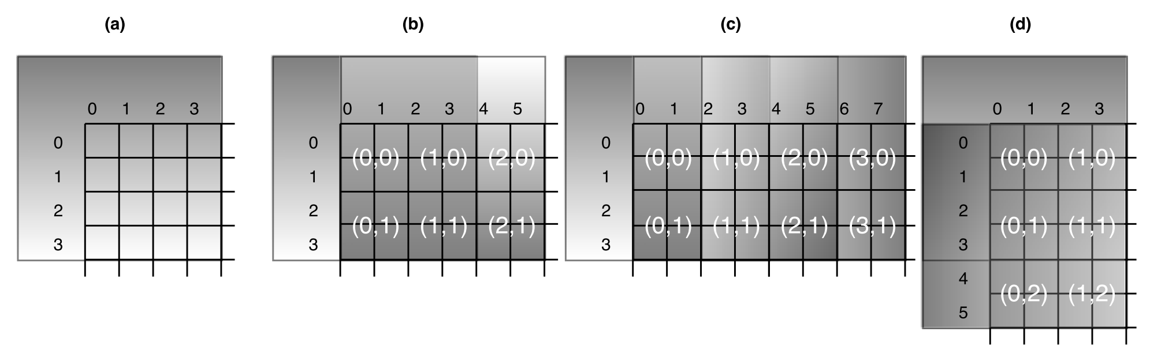
Re-use Tiles in RFBME

Slide 58
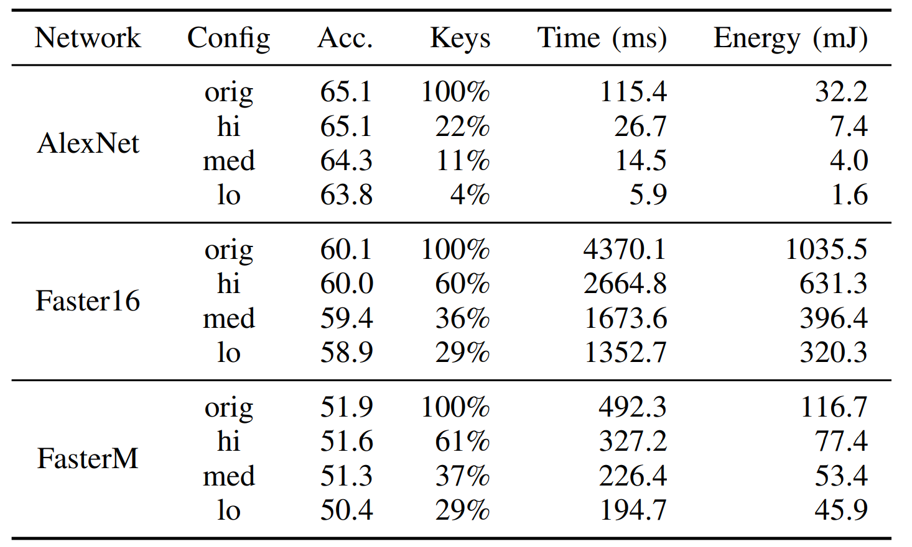
Changing Error Threshold

Slide 59
Different Adaptive Key Frame Metrics

Slide 60
Normalized Latency & Energy

Slide 61
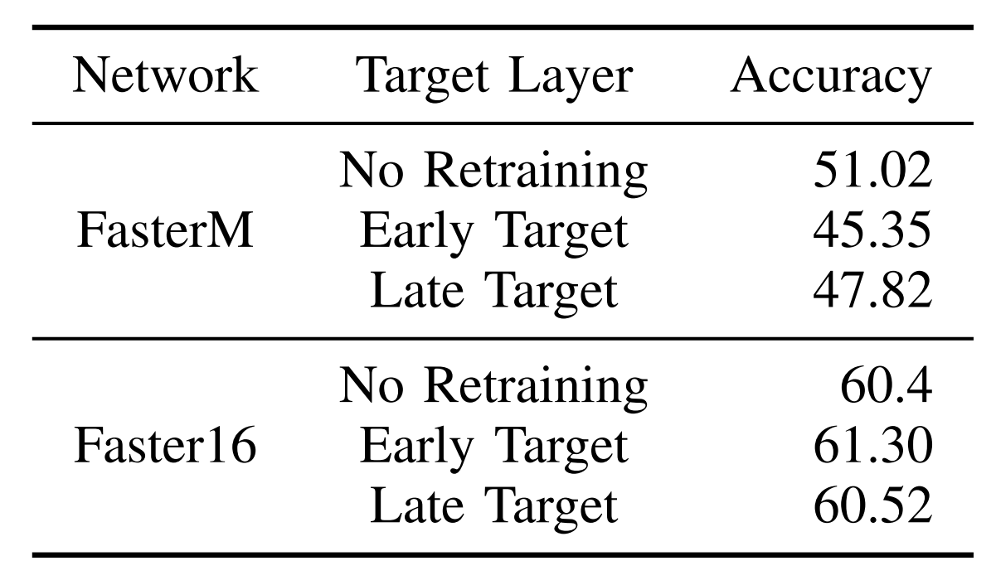
How about Re-Training?

Slide 62
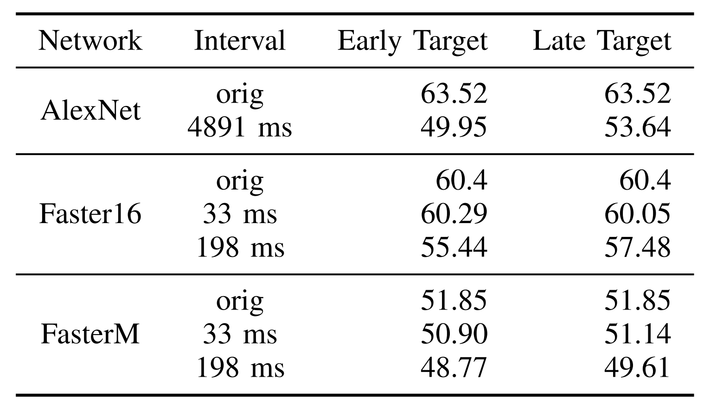
Where to cut the network?

Slide 63


#MakeRyanGoslingTheNewLenna
Lenna dates back to 1973
We need a new test image for image processing!

